Slide 1
Saket Mohan
Founder & CEO
SECURE ELEMENTS
United Kingdom
Generative AI in Automotive Cybersecurity Threat Modeling

Slide 2
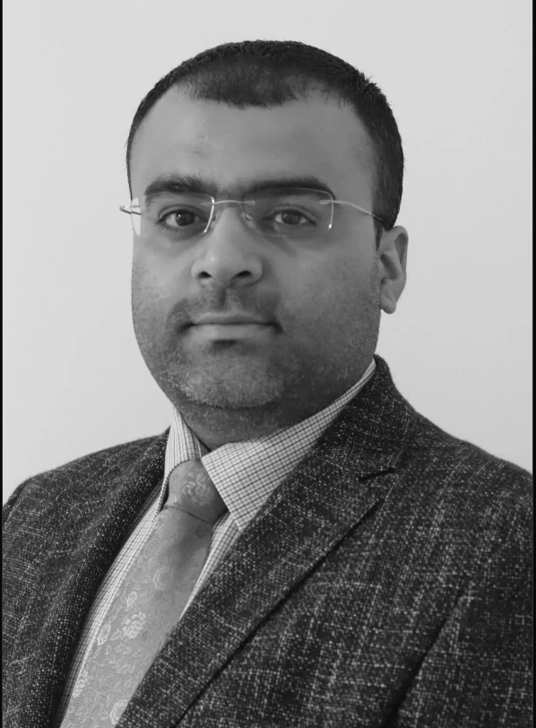
Saket Mohan is the Founder and Director of Secure Elements Ltd, with over 12 years of experience in Connected Cars and Automotive Cybersecurity. He has held key roles at ClearMotion UK Ltd and EDAG Engineering Limited, and his background includes extensive work in Telematics and Cybersecurity. He holds an M.Sc. in Embedded and Wireless Systems from Coventry University, UK.

Slide 3
Introduction
Importance of cybersecurity in connected and autonomous vehicles
Introduction of Generative AI in enhancing threat modeling
Overview of the CRISKLETM platform
Need to add overall picture of Criskle

Slide 4
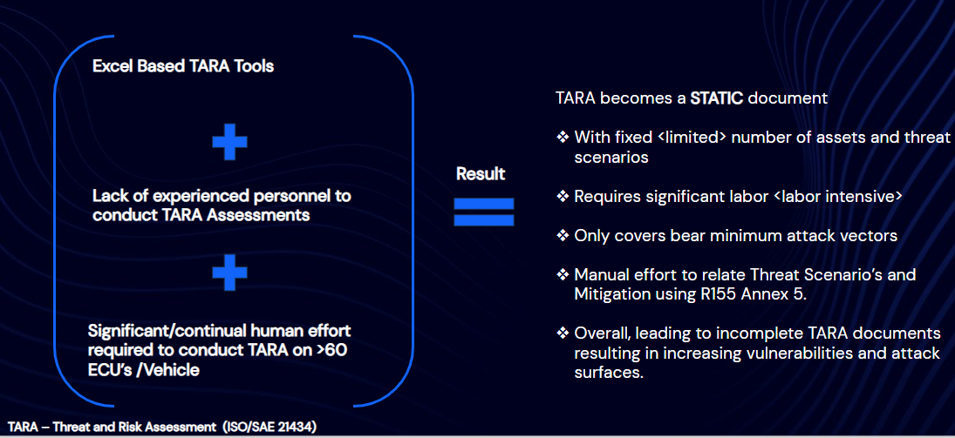
Problem Statement
Increasing connectivity in vehicles poses significant cybersecurity risks.
Traditional threat modeling methods may not be sufficient
Need for innovative approaches like Generative AI for threat scenario generation and attack simulation.

Slide 5
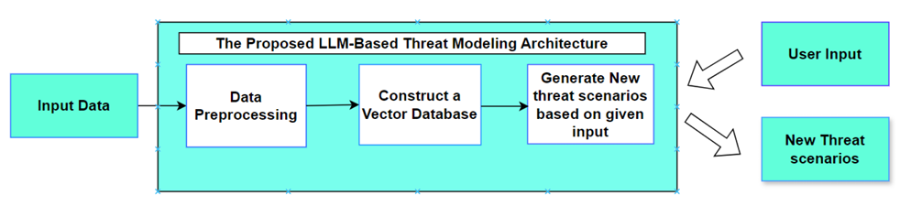
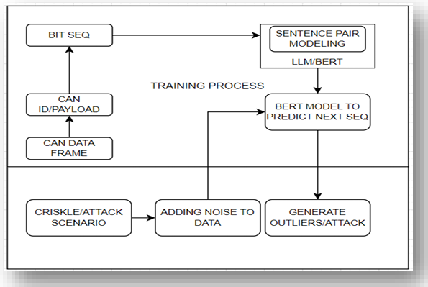
Methodology
Threat Modeling Architecture
Attack Simulation Architecture

Slide 6
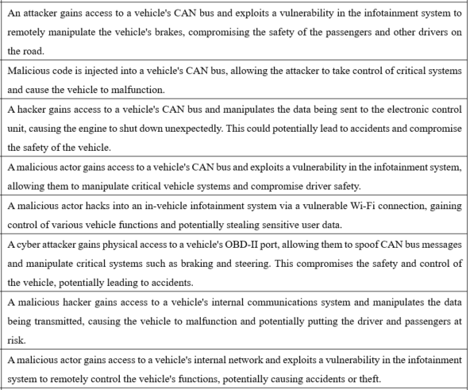
Threat Modeling with AI
UNECE R155 Defined Attack -
The attacker spoofs traffic on the GMSL bus to exploit a vulnerability in running services or hardware, thereby compromising asset integrity
Model Generated Attack Scenarios

Slide 7
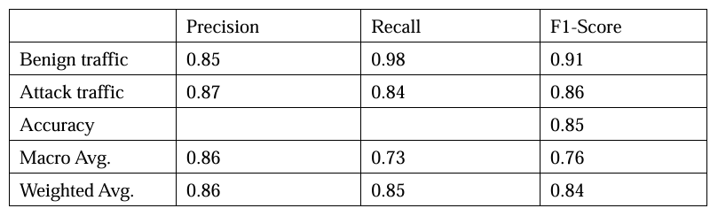
Results

Slide 8
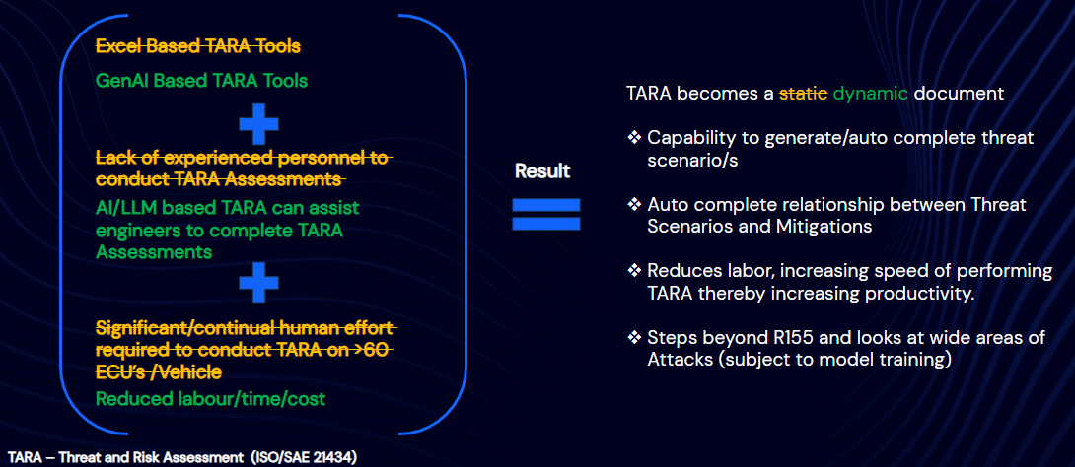
Discussion & Implications
Implications of using Generative AI in real-world automotive cybersecurity
Potential for reducing the manual effort in threat modeling
The importance of dataset size and quality in improving model performance

